Slide 1
AUTOMATIC ROBOVAC
Project Guide
Jaison C V
PRESENTED BY
Alphin A J
Aswin V Babu
Shahabas V Aman
Shebin KS
Ujjwal Babu

Slide 2
INTRODUCTION
In the current situation of rapid growing population, waste collection and disposal becomes a major challenge.
This project deals with eliminating the need to manually collecting the waste by automating the process
The automatic cleaning machine includes a vaccum setup, robotic arm for bottle pick and also a brush type setup infront of the robot for waste collection.

Slide 3
LITERATURE SURVEY
Name of the author | Year of publication | Title of the paper | Description
S. Navaneetha, P. Venkata Ramana | 2021 | Design and fabrication of a robot for scrap collection | A programmed piece gathering robot which is designed to expel scraps from any territory with the assistance of sheet metal.
Namratha A M, Nandini S | 2019 | Automatic waste management and segregation using IOT | The Automatic waste management and segregation system use the concept of IoT, where the proposed system is placed all over the cities, with an embedded system to segregate and monitor the level of the bin.

Slide 4
OBJECTIVES
Wireless control
Automatic movement of robot with waste .
Real time Vacuum Cleaner action and waste picking with robotic arm.
Waste disposal without any human intervention.

Slide 5
BLOCK DIAGRAM
ULTRASONIC SENSOR
RASPBERRY PI
NODE MCU
VACUUM CLEANING MODULE
POWER SUPPLY
DC MOTOR (BRUSH)
CAMERA
BUCK CONVERTER
L293D MOTOR DRIVER
MOTOR 1 & 2
MOTOR 3 & 4
ROBOTIC ARM

Slide 6
COMPONENTS AND COST
SL NO | COMPONENT | COST
1. | Gear motor (5) | 730
2. | L293D Motor Driver | 260
3. | Ultrasonic ranging module | 210
4. | Raspberry Pi 3 Model B+ | 5500
5. | ESP 8266 | 400
6. | Buck converter | 250
7. | Robotic Arm | 3550
8. | Lithium-ion battery(12v-1.5A) | 700
9. | Web camera | 700

Slide 7
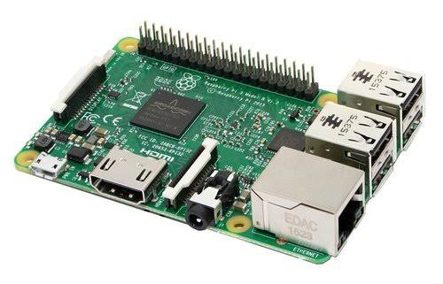
HARDWARE COMPONENTS :
RASPBERRY PI MODEL 3B +
64 bit quad core processor, on board WiFi and Bluetooth and USB features .
processing speed (700 MHz - 1.4 GHz)
RAM memory : (256MB -1GB).
Introduced by Raspberry Pi Foundation, comes with CPU, GPU, USB ports and i/o pins and capable of doing some simple functions like regular computer.
It consists of 40 GPIO pins that are used for connection with other devices.

Slide 8
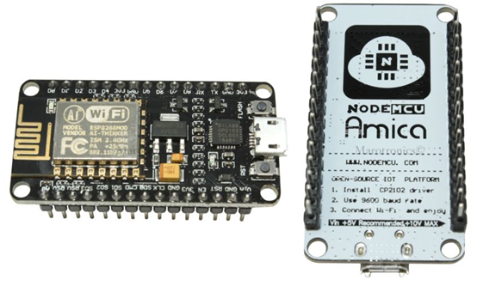
NODE MCU ESP8266
(Node MicroController Unit) - an open source software and hardware development environment that is built around a very inexpensive System-on-a-Chip (SoC).
Designed and manufactured by Espressif Systems, contains all crucial elements of the modern computer: CPU, RAM, networking (wifi),

Slide 9
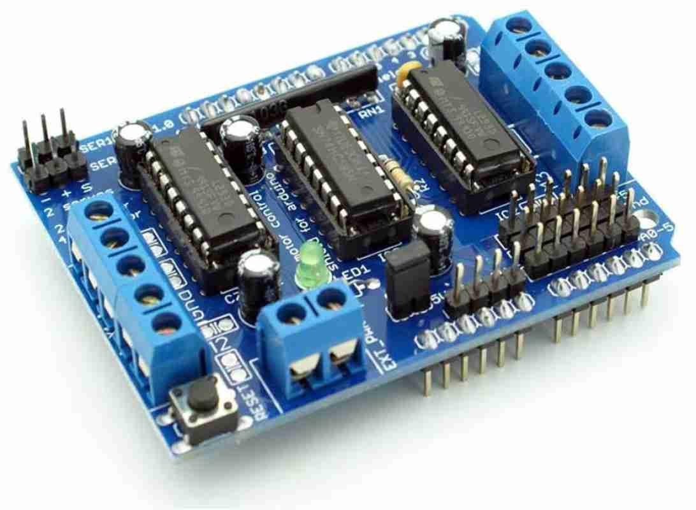
L293D MOTOR DRIVER
A motor driver IC is an integrated circuit chip which is usually used to control motors in autonomous robots. Motor driver ICs act as an interface between microprocessors in robots and the motors in the robot.
L293D has 16 pins, they are comprised as follows:
Ground Pins - 4
Input Pins - 4
Output Pins - 4
Enable pins - 2
Voltage Pins - 2

Slide 10
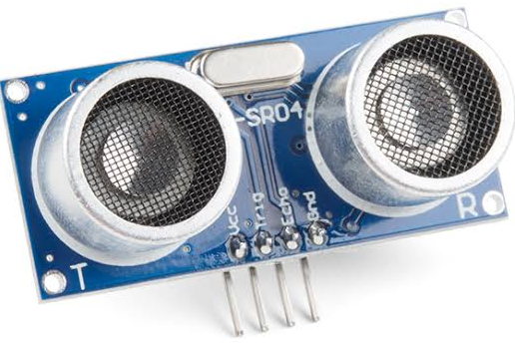
ULTRASONIC SENSOR
HC-SR04 ultrasonic distance sensor.
Provides 2cm to 400cm of non-contact measurement functionality with a ranging accuracy that can reach up to 3mm.
Each HC-SR04 module includes an ultrasonic transmitter, a receiver and a control circuit.
Four pins : VCC (Power), Trig (Trigger), Echo (Receive), and GND (Ground).

Slide 11
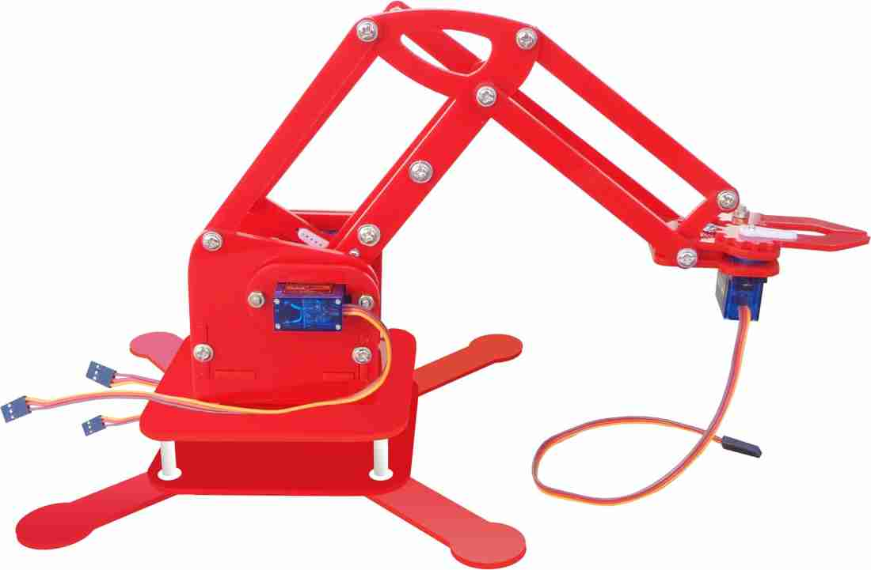
ROBOTIC ARM
Automate the process of placing goods or products onto pallets. By automating the process, palletizing becomes more accurate, cost-effective, and predictable.
The use of robotic arms also frees human workers from performing tasks that present a risk of bodily injury.
Material Handling, Welding Inspection, Pick and Place.

Slide 12
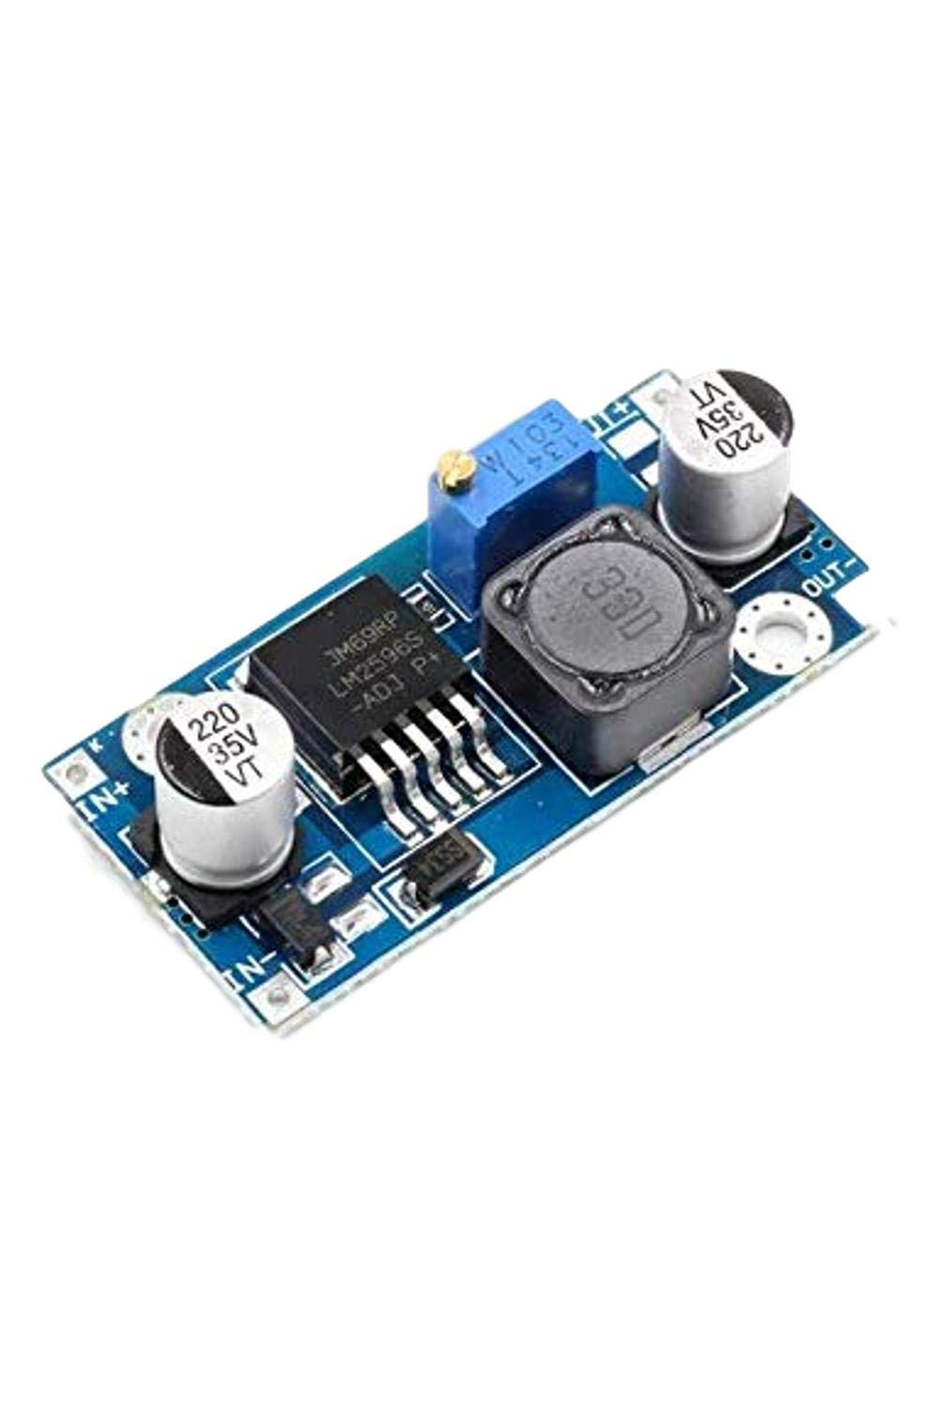
L2596 BUCK CONVERTER
DC – DC power converter which steps down voltage (while drawing less average current) from its input (supply) to its output (load).
For our case input is about 12v and output is 5v

Slide 13
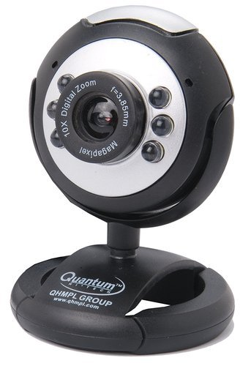
WEB CAM
Inbuilt sensitive microphone and image sensor
Image resolution interpolated to 25 mega pixels with 6 light sensors ; 16 MP Image Resolution ; USB Interface ; Night Vision ; Usb Cable Length: 1m
Focus Range 4cm to infinity
Resolution hardware: 500K pixels
Image quality: RGB24
Interface: USB 2.0
Frame rate: 30 fps (max)

Slide 14
SPECIFICATIONS :
Raspberry Pi 3B +
SoC : Broadcom BCM2837B0 quad core A53 (ARMv8) 64-bit @1.4 Ghz
RAM : 1 GB LPDDR2
Networking : Gigabit Ethernet,2.4 and 5Ghz 802.11b/g/n/ac Wi-Fi , Bluetooth 4.2
Storage : Micro – SD
GPIO : 40-pin GPIO
Ports : HDMI ,3.5 mm audio jack,Camera Serial Interface ,Display Serial Interface
Power source : 5V 2.5A
Node MCU ESP8266
Microcontroller : Tensilica 32-bit RISC CPU Xtensa LX106
Digital I/O pins : 16
Analog Input pins : 1
SRAM : 4kb
Flash Memory : 4MB
Networking : 2.4G-2.5G (2400M-2483.5M) , 802.11 b/g/n
Power source : 5V 80mA

Slide 15
Buck Converter
Input supply : 3-40V
Output load : 1.5-35V 3A (max)
Switching frequency : 150 Khz
L293D Motor Driver
Input supply : 5V
Input pins : 4
Output current : 600mA per channel
DC Gear motors
12v , 10 RPM central shaft gear motors x 5

Slide 16
YOLO ALGORITHM
YOLO is an abbreviation for the term ‘You Only Look Once’. This is an algorithm that detects and recognizes various objects in a picture (in real-time).
YOLO algorithm employs convolutional neural networks (CNN) to detect objects in real-time. As the name suggests, the algorithm requires only a single forward propagation through a neural network to detect objects.
YOLO is an algorithm that uses neural networks to provide real-time object detection. This algorithm is popular because of its speed and accuracy.
The YOLO algorithm consists of various variants. Some of the common ones include tiny YOLO,YOLO V1, YOLO V2, YOLO V3.

Slide 17
TERMS RELATED WITH YOLO
YOLO algorithm works using the following three techniques:
Residual blocks
Bounding box
Non max supression

Slide 18
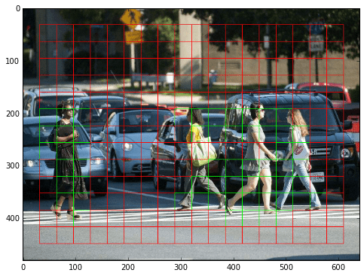
RESIDUAL BLOCKS
First, the image is divided into various grids. Each grid has a dimension of S x S. The following image shows how an input image is divided into grids.
In the image above, there are many grid cells of equal dimension. Every grid cell will detect objects that appear within them. For example, if an object center appears within a certain grid cell, then this cell will be responsible for detecting it.

Slide 19
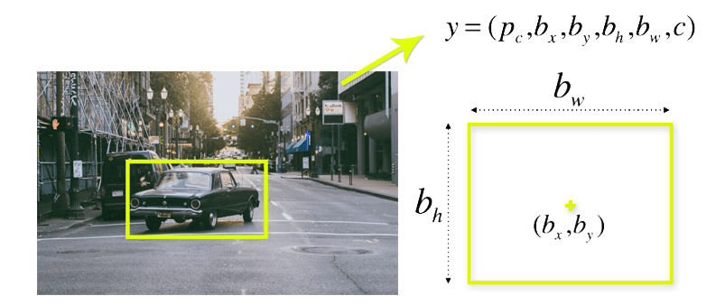
BOUNDING BOX
A bounding box is an outline that highlights an object in an image.
Every bounding box in the image consists of the following attributes
Width (bw)
Height (bh)
Class (for example, person, car, traffic light, etc.).This is represented by the letter c.
Bounding box center (bx,by).

Slide 20
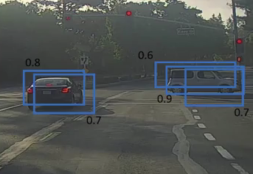
NON MAXIMUM SUPRESION
Non-Max Suppression, One of the most common problems with object detection algorithms is that rather than detecting an object just once, they might detect it multiple times. Consider the below image.
Here, the cars are identified more than once. The Non-Max Suppression technique cleans up this up so that we get only a single detection per object.

Slide 21
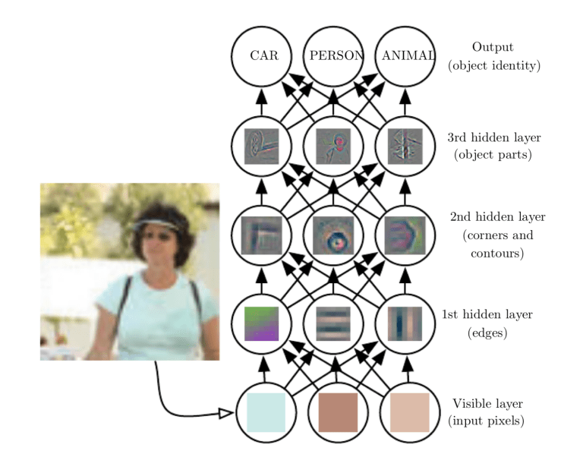
CONVOLUTION NEURAL NETWORK (CNN)
Convolutional neural networks, also known as CNNs or Convnets, use the convolution technique introduced above to make models for solving a wide variety of problems with training on a dataset.

Slide 22
APPLICATION OF YOLO
Autonomous driving
Wildlife protection
Security
Pick and place

Slide 23
CIRCUIT DIAGRAM

Slide 24
WORKING OF PROPOSED SYSTEM
Connection :
Power supply – 12V 1A (AC adapter).
Buck converter ( DC to DC power converter ) steps down voltage from its input (supply) to its output (load).Works as a SMPS.
Steps down 12v into 5v.
Node MCU connected to 5v supply.
Motor driver and vacuum motor connected to 12v directly.
Web cam connected to raspberry pi via type A cable.
Raspberry pi connected to Node MCU through RXDO and TXDO pin (GPIO14 and GPIO15).
Servomotors of Robotic arm ,Ultrasonic sensor connected to Node MCU.

Slide 25
WORKING
In our proposed method, Raspberry PI and Node MCU is used as a core controller. The ultrasonic sensor is used for the proper pathway of the sytem.
System consist of 4 DC motors for the rotation of 4 wheels, L293D motor driver IC is an integrated circuit chip which is usually used to control motors in autonomous robots.
As the vehicle moves in zig zag manner, the ultrasonic sensor detects any obstacle present infront
Then using web cam in real time , object detection(plastic bottle) takes place using machine learning via YOLO algorithm.
When the plastic bottle is detected , a signal (HIGH) is sent from raspberry pi to Node MCU and the robotic arm picks up the detected bottle by moving at certain angles
System also include a vacuum setup which works all the time for the collection of dirt which is collected by a dustbag for later disposal.
It also consists of a brush type setup powered by a dc motor to collect plastic covers,and other kind of wastes.

Slide 26
Automatic : (Raspberry pi) or manual control(mobile control using Blynk).
Manual control : As the object gets detected by machine learning , a notification sent to blynk app.
The blynk app consists of joystick, slider to control the vehicle.

Slide 27
ADVANTAGES
Waste disposal without any human intervention.
Easily controllable(through android application).
Automatic movement of robot with decision making.
Real time Vacuum Cleaner action and waste picking.
Faster and easier waste management.

Slide 28
DISADVANTAGES
Continuous power supply.
Can’t differentiate waste materials accurately.
Waste storing capacity
Weight.
Not efficient enough.

Slide 29
CONCLUSION
This project provides a solution to waste management with the advancement of vacuum cleaning setup and the implementation of machine learning to detect and collect waste materials.
Works on plain areas to collect bottles ,plastic covers etc..
The system can be controlled either automatically or manually by Blynk server remotely.
It allows wireless transmission of data which can be accessed anywhere by connecting to cloud via GSM module.
The system can be further modified with LDR sensor for fast and efficient working.
With the advancement in AI ,waste collection becomes more systematic and easier.

Slide 30
REFERENCE
[1] Rohidas Waykole, Vedang Pujari, Ajay Powar and Umakant Patil (2018) ‘Electromagnetic Scrap Collecting Machine with Vacuum System’, International Research Journal of Engineering and Technology (IRJET) .
[2] Kazacos Winter, J. (2013). Android controlled mobile robot| (Master's thesis).
[3] Nayak, S., Hood, B., Allen, O., Foskey, C., Stevens, R., Kallal, E. & Schwartz, E. M. (2009). TailGator: Design and Development of Autonomous Trash collecting Robot. In Florida conference on recent advances in robotics .
[4] Shah, A., Pant, M., & Karamchandani, S. (2019, March). Unsupervised Maneuvering Robot for Scouring Application. In 2019 IEEE 5th International Conference for Convergence in Technology (I2CT) .
[5] Kee, G. M., Zain, Z. M., & Salimin, R. H. (2008, September). Design and Development PIC-Based Autonomous Robot. In 2008 IEEE Conference on Robotics, Automation and Mechatronics . IEEE.
[6] Kee, G. M., Zain, Z. M., & Salimin, R. H. (2008, September). Design and Development PIC-Based Autonomous Robot. In 2008 IEEE Conference on Robotics, Automation and Mechatronics . IEEE.

